Slide 1
Air Quality Forecasting (CO2 Emissions)
TEAM:
Chandrakanth Naidu G
Warsha. B
Ramani N
Nikhil Naganur

Slide 2
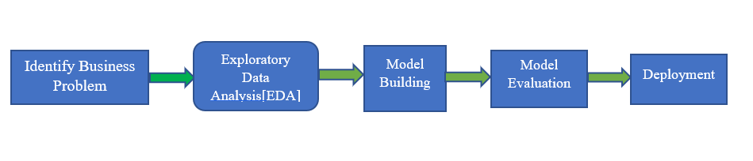
Business Problem:
To forecast Co2 levels for an organization so that the organization can follow government norms with respect to Co2 emission levels.
Objective: The objective of the analysis is to forecast Co2 emission levels for an organization
Project Architecture / Project Flow
Figure: Workflow Of Project

Slide 3
Identify Business Problem:
Firstly, We have to find our business problem, in our case to forecast Co2 levels for an organization, which helps to the organization to follow government norms with respect to Co2 emission levels
Identify Business Problem:
Firstly, We have to find our business problem, in our case to forecast Co2 levels for an organization, which helps to the organization to follow government norms with respect to Co2 emission levels
Exploratory Data Analysis(EDA):
Exploratory Data Analysis (EDA) is an approach to analyze the data using visual techniques. It is used to discover trends, patterns, or it check assumptions with the help of statistical summary and graphical representations.
Model Building:
In this Phase, we have to split our dataset into training and test dataset and build Machine learning models on our dataset.
Deployment:
In this phase, we have to deploy our model into production environment to make practical business decisions based on data.

Slide 4
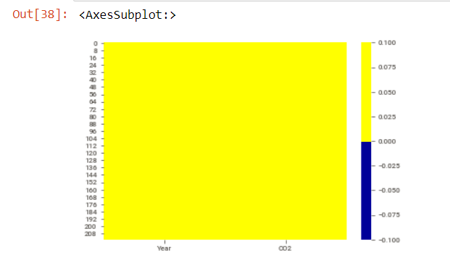
Data understanding: basic metrics in the dataset
The data set contains two variables which are Year and CO2.
FINDING MISSING VALUES
In our dataset, there are no null or missing values present
Fig: Graphical representation of finding missing values by using heatmap

Slide 5
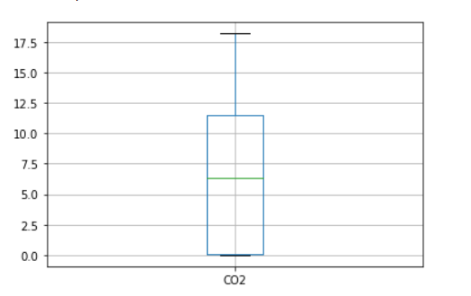
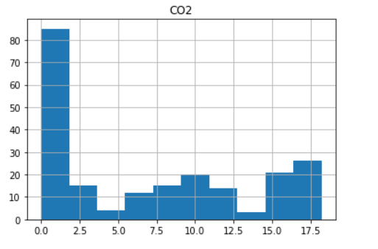
OUTLIER DETECTION
Histogram for distribution of data
In our dataset, there seem to be no outliers
Fig: Finding outliers by using boxplot

Slide 6
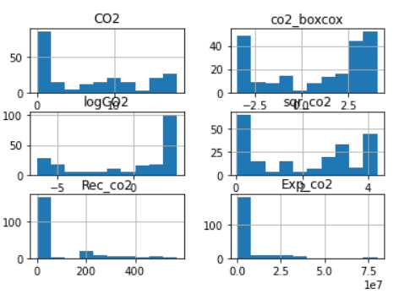
Implementation of Transformation

Slide 7
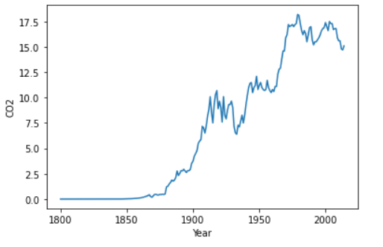
VISUALIZATION
Graphical representation of the Co2 emissions between the years 1800 and 2014 using line plot
Fig : Graphical representation between year and CO2

Slide 8
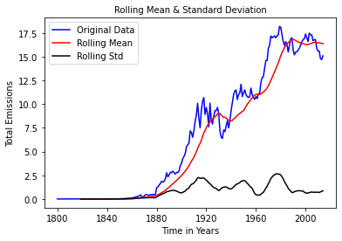
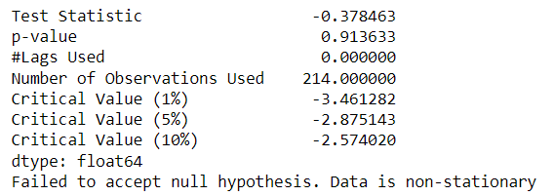
Checking whether the data is stationary or not
Test stationary of our data by using Augmented Dickey Fuller’s test,
it shows that the data is non-stationary

Slide 9
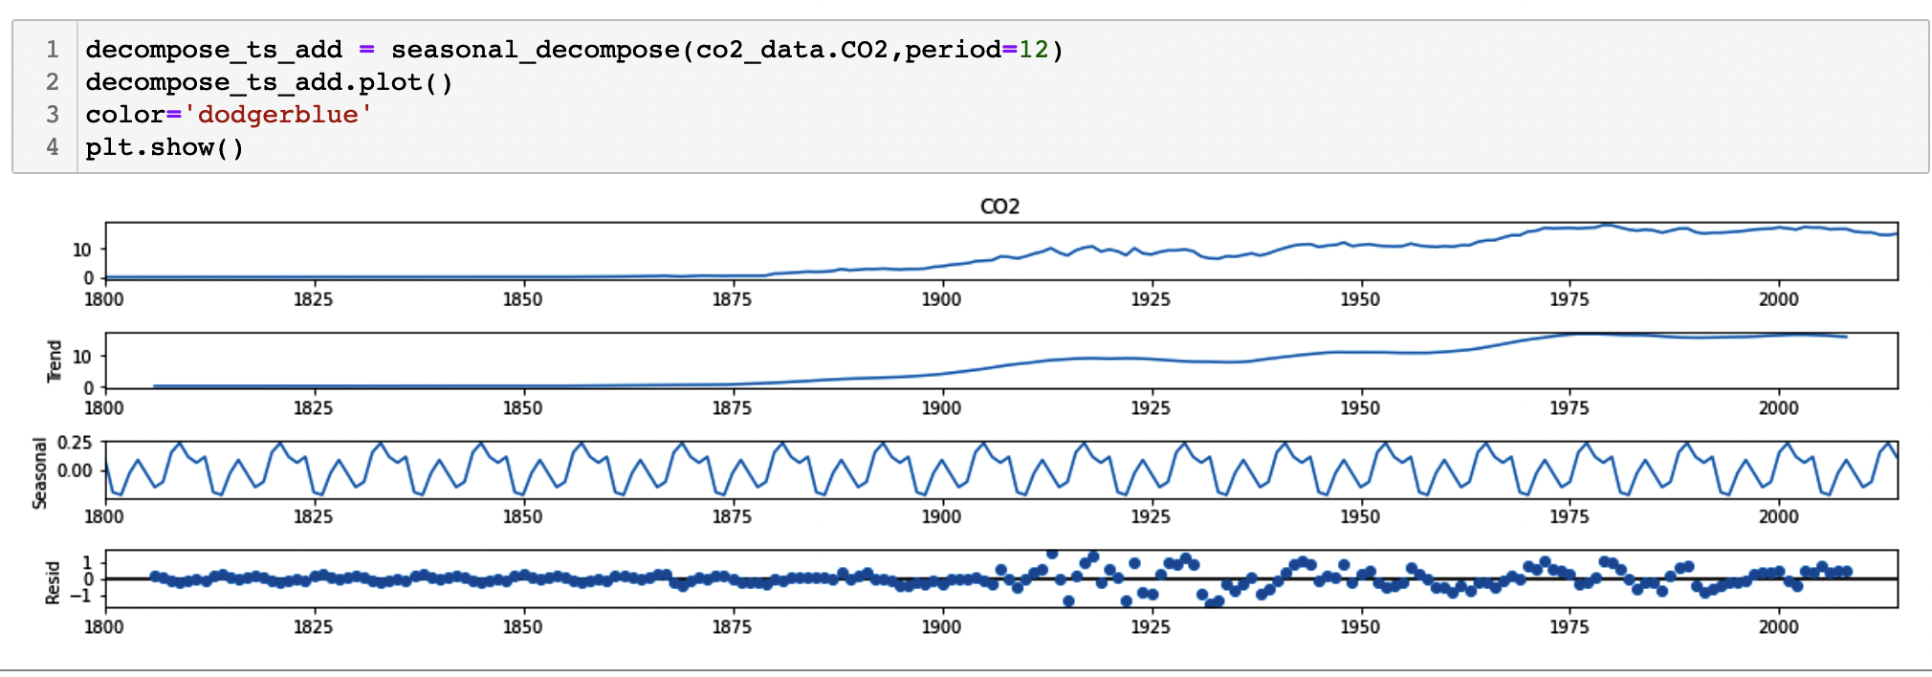
Trend and Seasonality: Decomposing the Time Series
We can see that the trend is the value that is causing the increasing pattern.
Seasonality information extracted from the series does not show any increasing or decreasing patterns.
The residuals show periods of low variability in the early years of the series

Slide 10
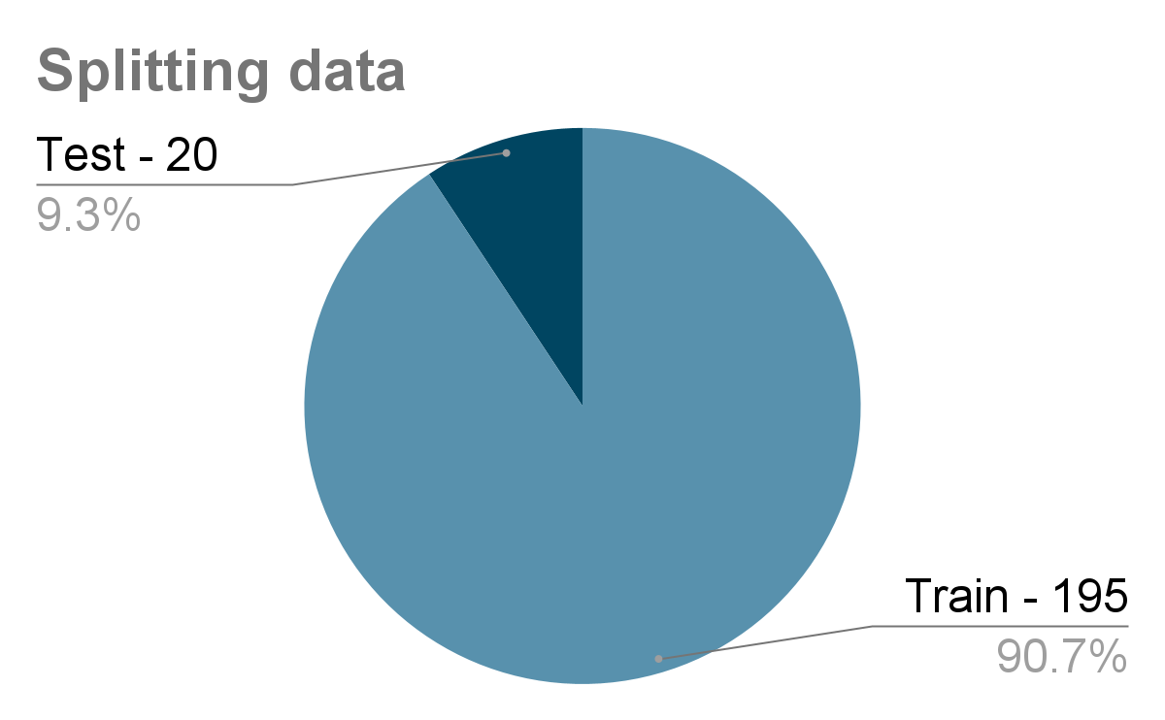
MODEL BUILDING

Slide 11
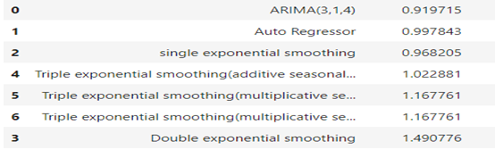

Hyper-parameter Tuning: finding the optimal (p,d,q)
Evaluated combinations of p, d and q values for an ARIMA model Choosing best ARIMA with least RMSE
Comparing various models

Slide 12
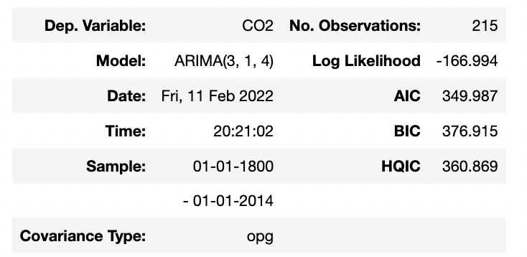
MODEL SELECTION
The Final Model selected is ARIMA(3,1,4) which will be trained based on the complete original dataset
Reasons to choose this model:
Least RMSE values
Forecasted values vs Actual values graphs capturing more information when compared to other models

Slide 13
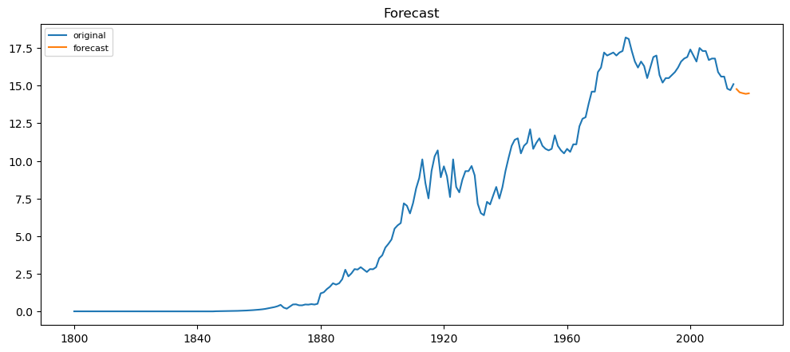
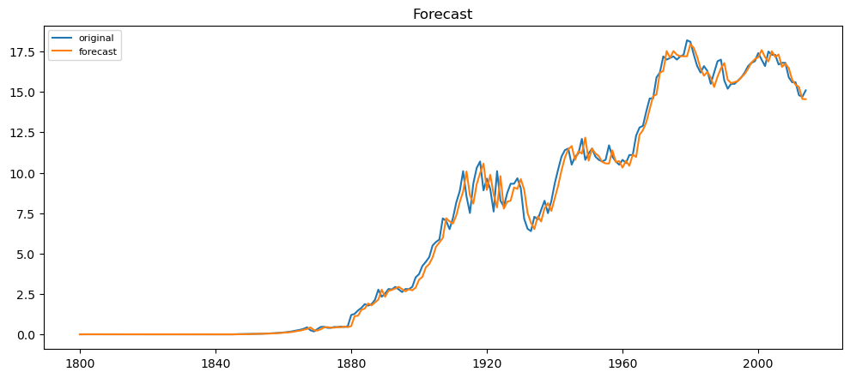
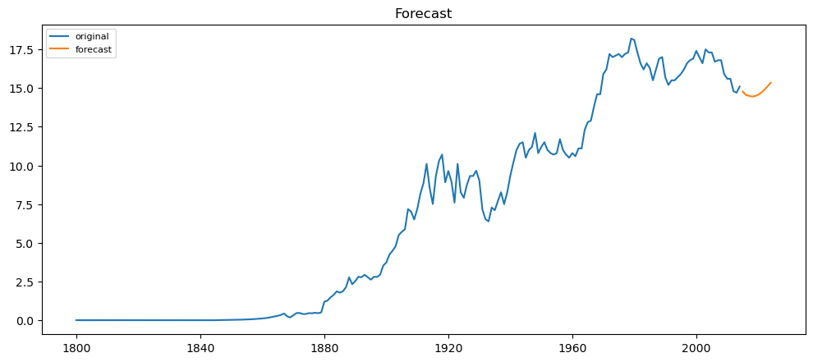
Forecasting for the next 5 years using ARIMA model
Forecasting the points using Arima
Forecasting for the next 10 years

Slide 14
Deployed the final model using Streamlit
Steps to run python application:
Open Anaconda Prompt in the project directory
Then run command : “ streamlit run app.py “
After opening of browser upload the dataset and choose number of years you want to forecast
Forecasted results and graph will be displayed

Slide 15
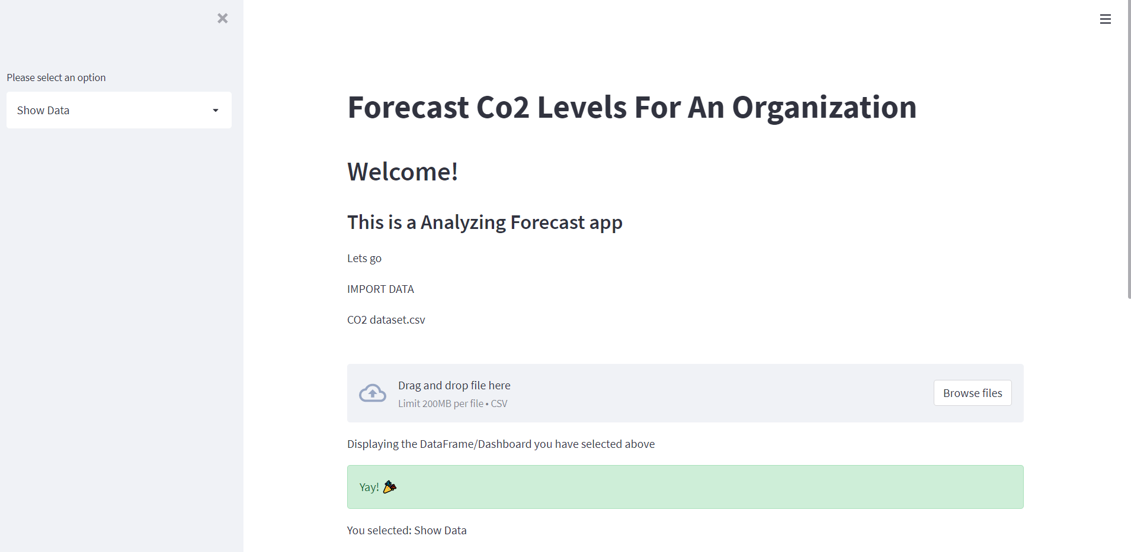
Forecasting app for co2 levels for an organization

Slide 16
The challenges
Model Selection:
Selecting the right model among several plausible models
Implementation challenges:
In Jupyter Notebook, Kernel issues occur in hyperparameter tuning
Deployment challenges:
creating the back end for our model deployment which was not giving the desire output
Execution Errors

Slide 17
How we overcame the challenges
Model Selection:
Choosing a model with low rmse value while also analysing EDA w.r.t to the model
Implementation challenges:
Updating the environment
Deployment challenges:
Researching and learning about using different kinds of deployment techniques
Fixing execution errors by identifying the type of errors caused

Slide 18


